Slide 1
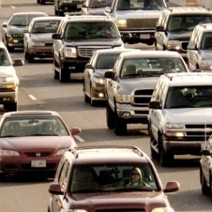

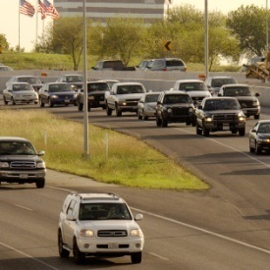
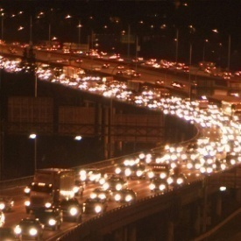
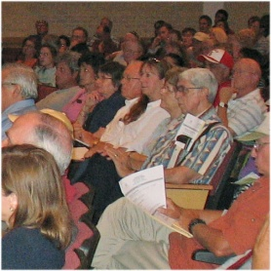
The Roads Ahead
Leroy D. Alloway, Director Community Development

Slide 2
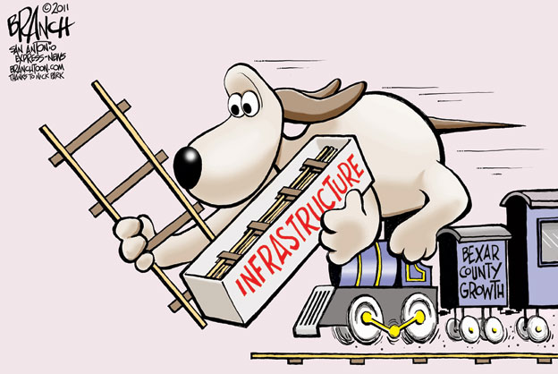

Slide 3
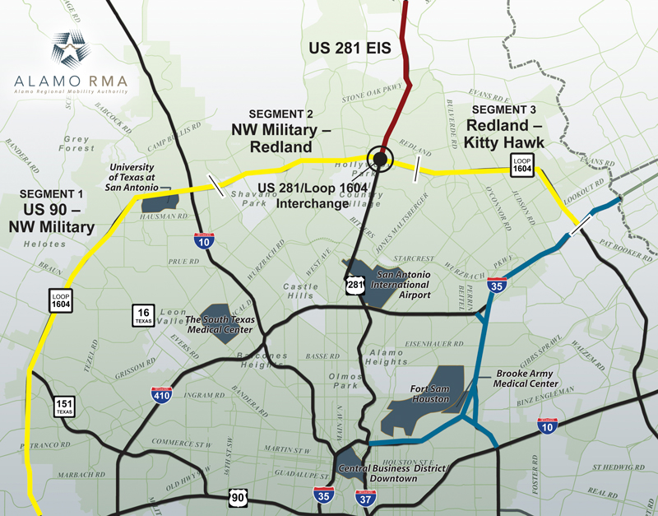

Slide 4
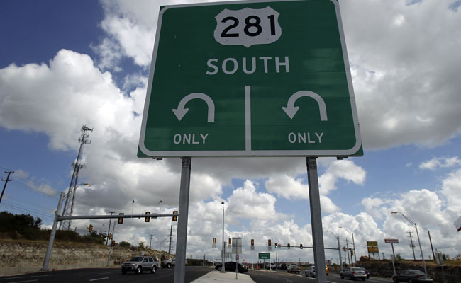
Photo from San Antonio Express-News – John Davenport

Slide 5
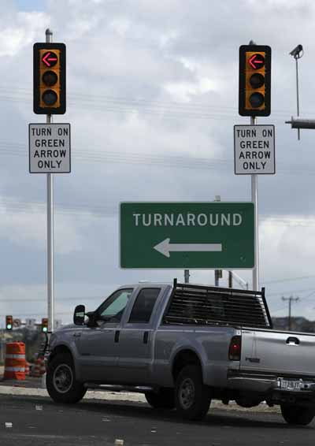

Slide 6
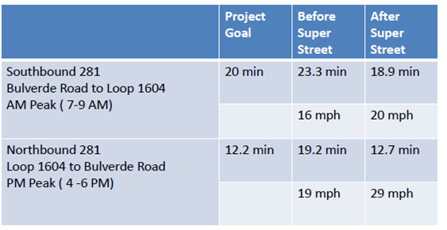
How is the Super Street working?

Slide 7
Are more trips being made on the 281 Super Street?
Location | 2010 Count | 2011 Count | % Increase
South of Evans Road | 74,000 vehicles per day | 81,526 vehicles per day | 10.17% increase in traffic
North of Evans Road | 60,100 vehicles per day | 63,552 vehicles per day | 5.74% increase in traffic

Slide 8
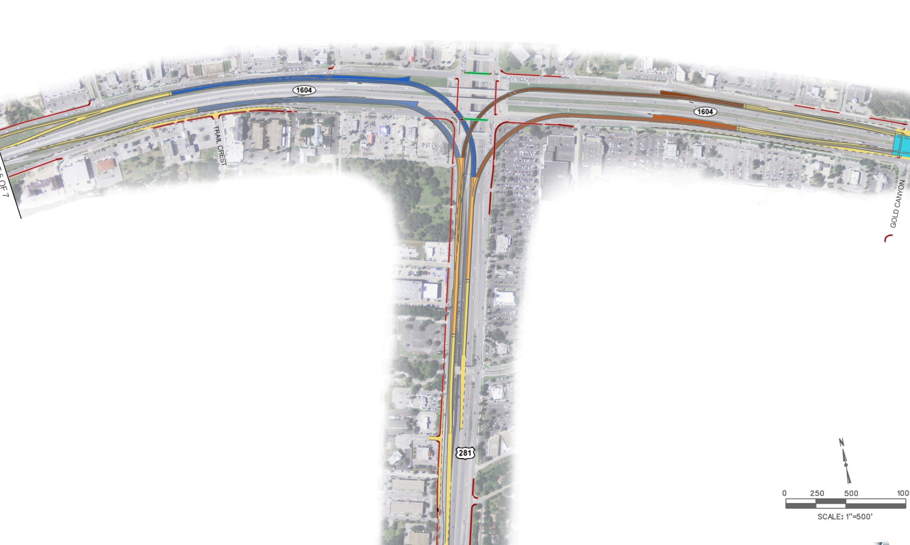
US 281 / Loop 1604 Interchange Project
Loop 1604 West to 281 South
Est. 2013 Traffic -
12500 Vehicles Per Day
Loop 1604 East to 281 South
Est. 2013 Traffic –
12550 Vehicles Per Day
281 North to Loop 1604 West
Est. 2013 Traffic -
13500 Vehicles Per Day
281 North to Loop 1604 East
Est. 2013Traffic -
11250 Vehicles Per Day

Slide 9
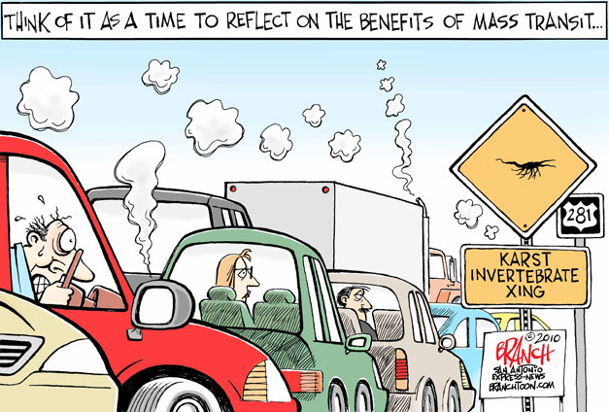

Slide 10
Why undertake environmental studies?
Answer the environmental questions once and for all – what impact could improvements have on the environment
Examine both non-toll and toll project alternatives through the Draft Environmental Impact Statement
Two estimated cost for the 2 Environmental Impact Statements is approximately $17 Million

Slide 11
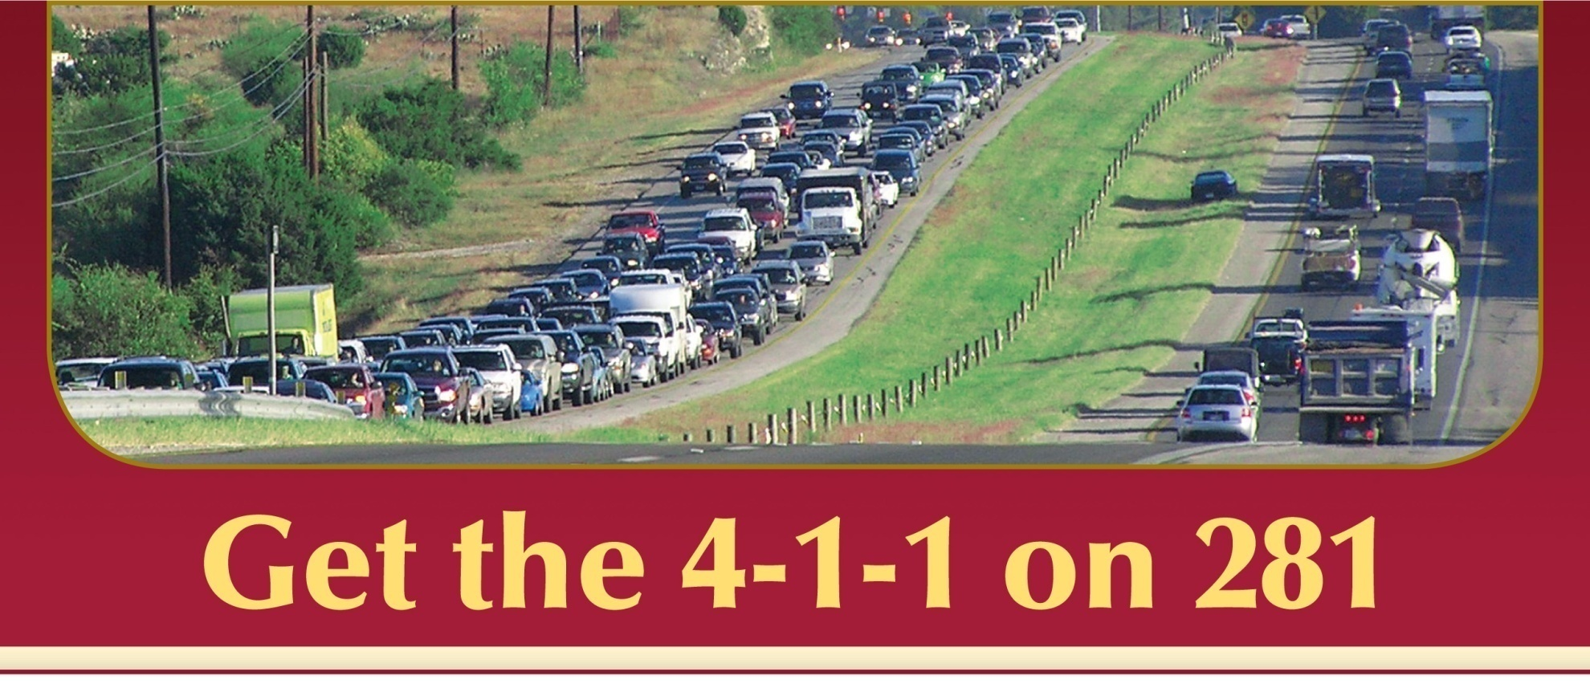
US 281 Environmental Impact Statement
Want more information? Visit the official US 281 EIS Pages online at www.411on281.com/US281EIS

Slide 12
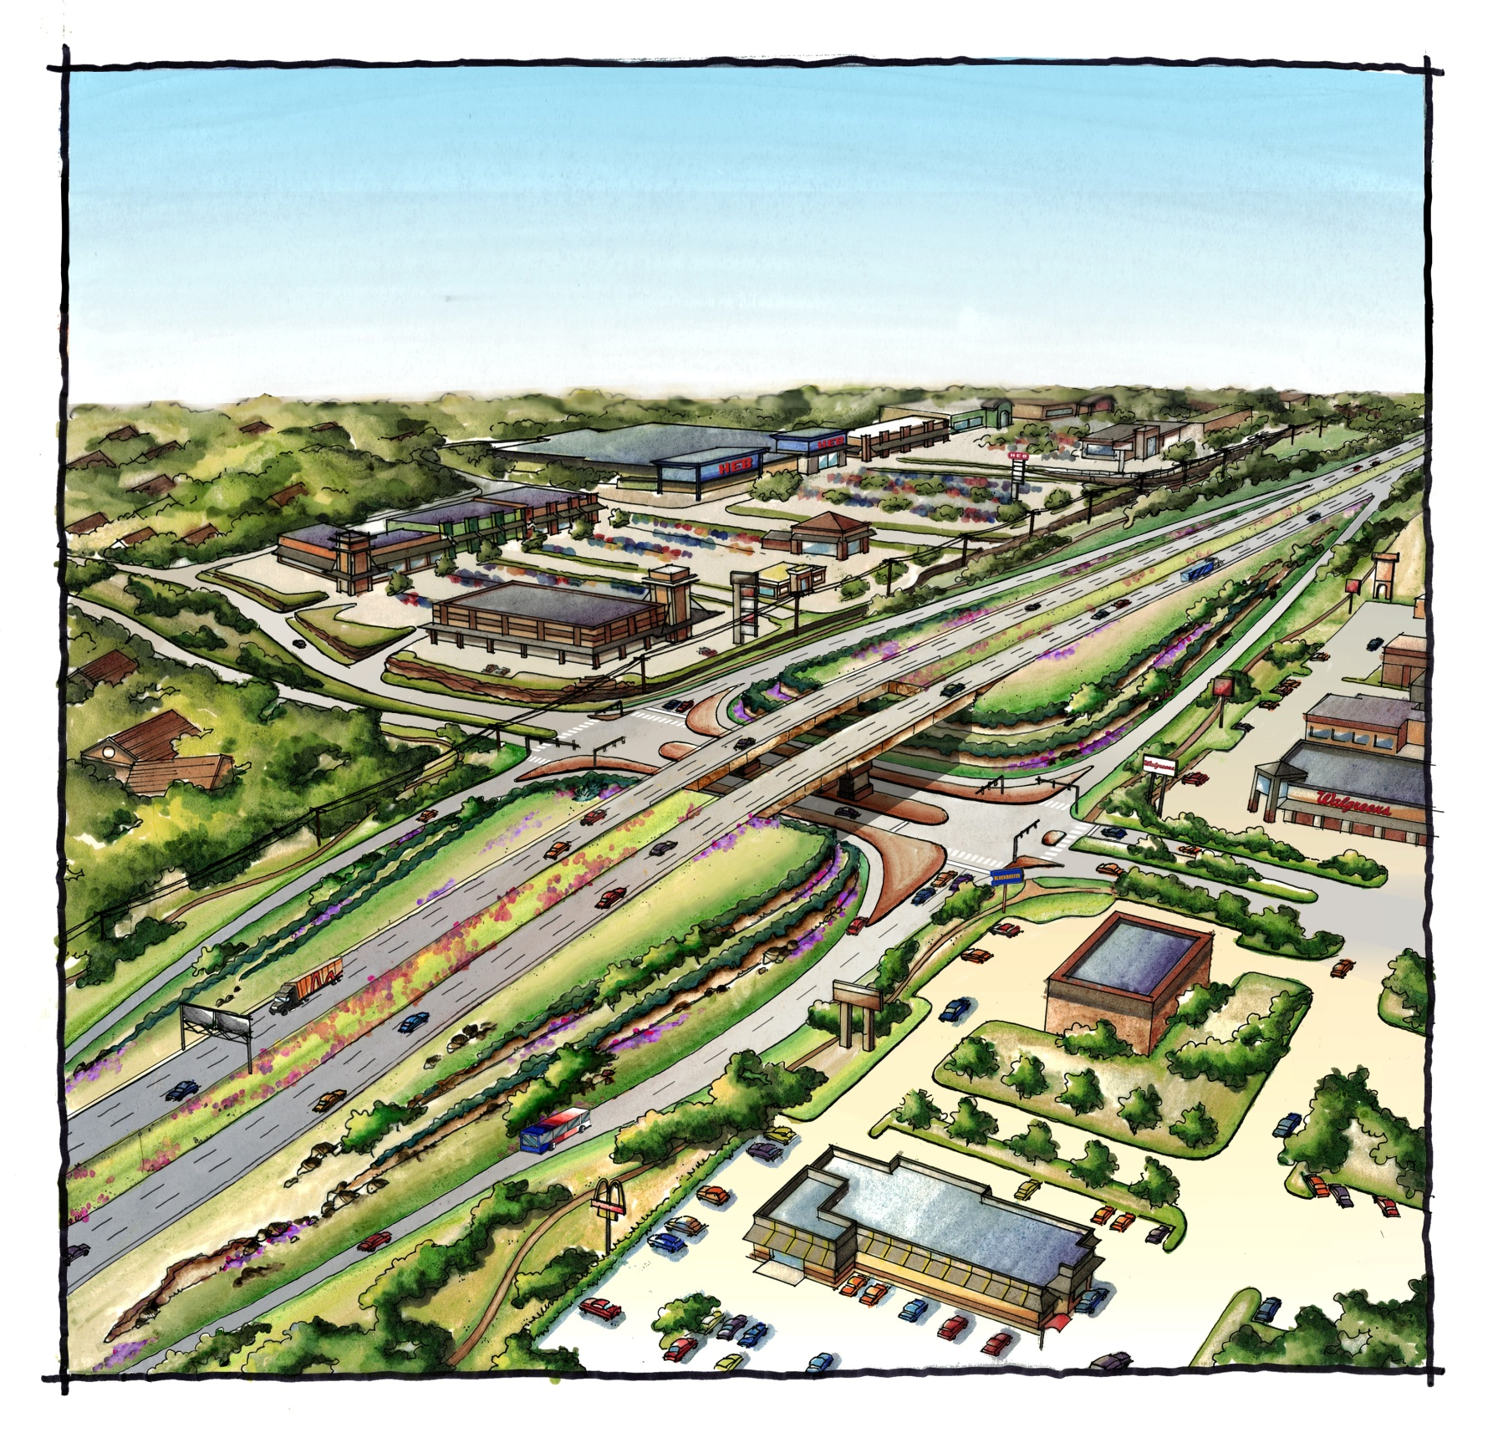
Overpass/ Expansion Alternative
Limited access highway…
means less construction cost
less need for additional right-of-way
less impervious cover
But with limited access roads…
new driveways and intersections could occur
costs, right-of-way and impervious cover would increase if some access roads are provided
access rights for some properties may have to be acquired
the highway would be more congested and operate at lower speeds

Slide 13
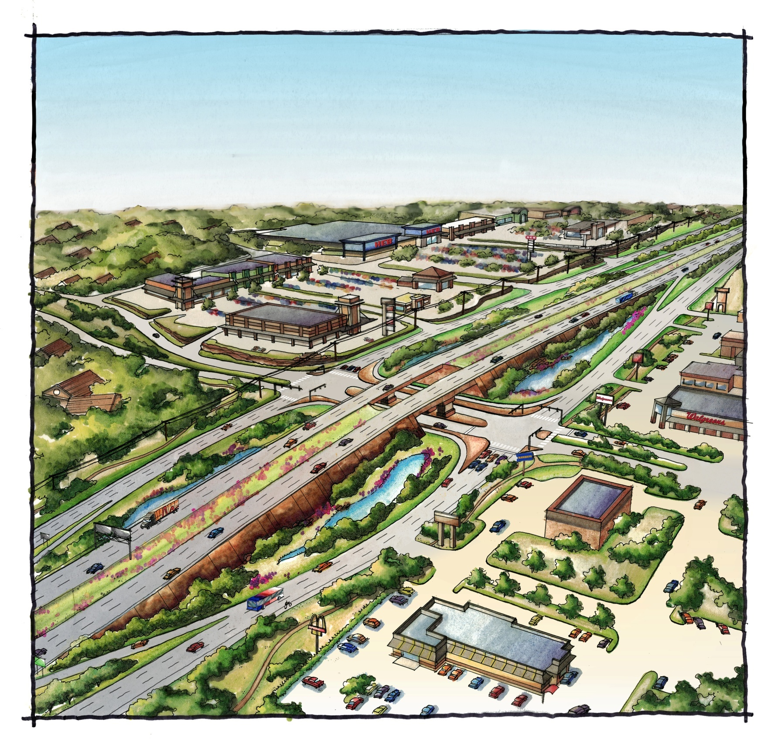
Expressway Alternative
Main lanes with continuous one-way frontage roads…
provide safe access for driveways and side streets
separate local traffic from through (main lane) traffic
allow the main lanes to be less congested and provide higher speeds
reduce high speed conflict points and lower crash rates
But with main lanes and continuous one-way frontage roads…
construction costs are higher
additional right-of-way is needed
more impervious cover is required

Slide 14
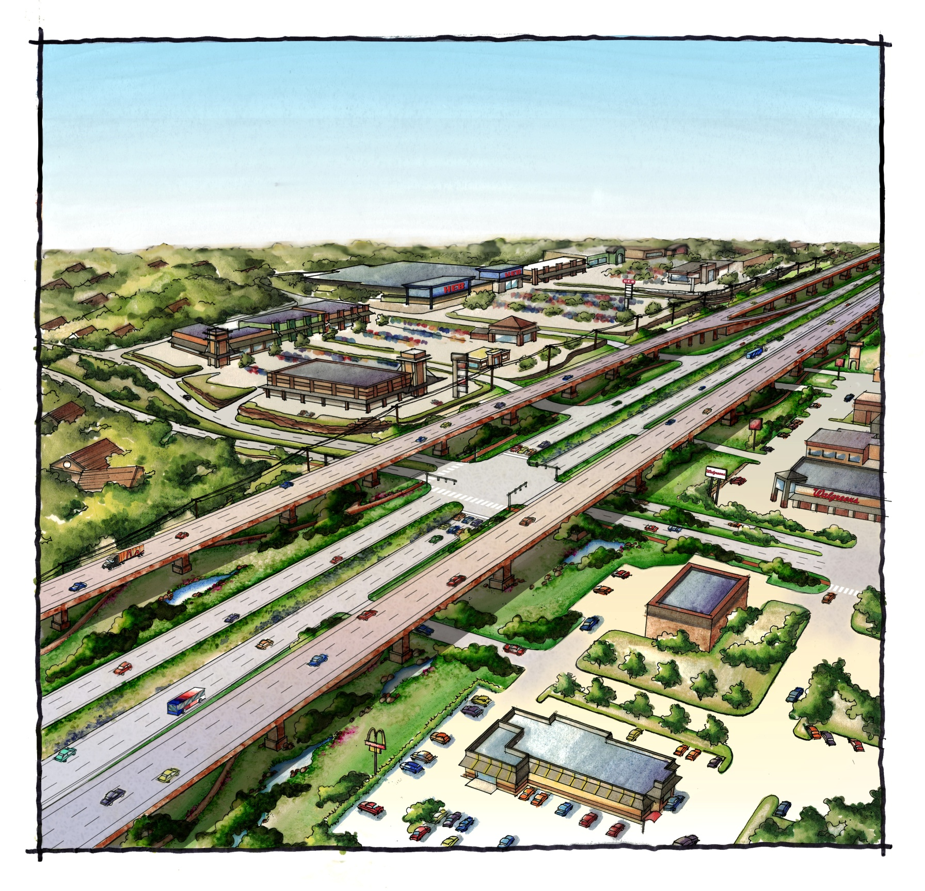
Elevated Expressway Alternative
Main lanes on continuous bridges…
mean less additional right-of-way and impervious cover
allow most of the existing pavement to remain as access roads
separate local traffic from through (main lane) traffic
allow the main lanes to be less congested and operate at higher speeds
reduce high speed conflict points and lower crash rates
But main lanes on continuous bridges…
mean higher construction cost
fewer on- and off-ramps for the elevated main lanes

Slide 15

Loop 1604 Environmental Impact Statement
Want more information? Visit the official Loop 1604 EIS Pages online at www.MoreFor1604.com

Slide 16
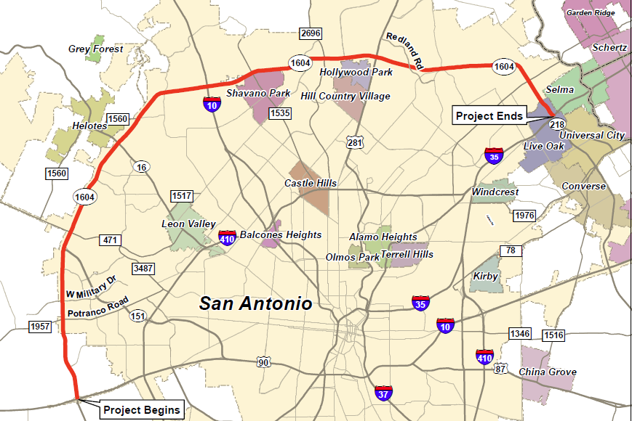

Slide 17
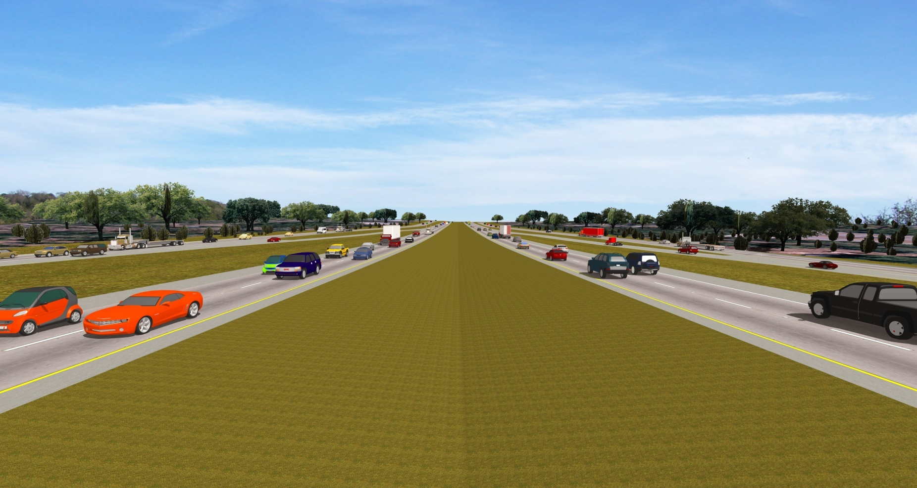
Loop 1604 Potential Alternatives – No Build

Slide 18
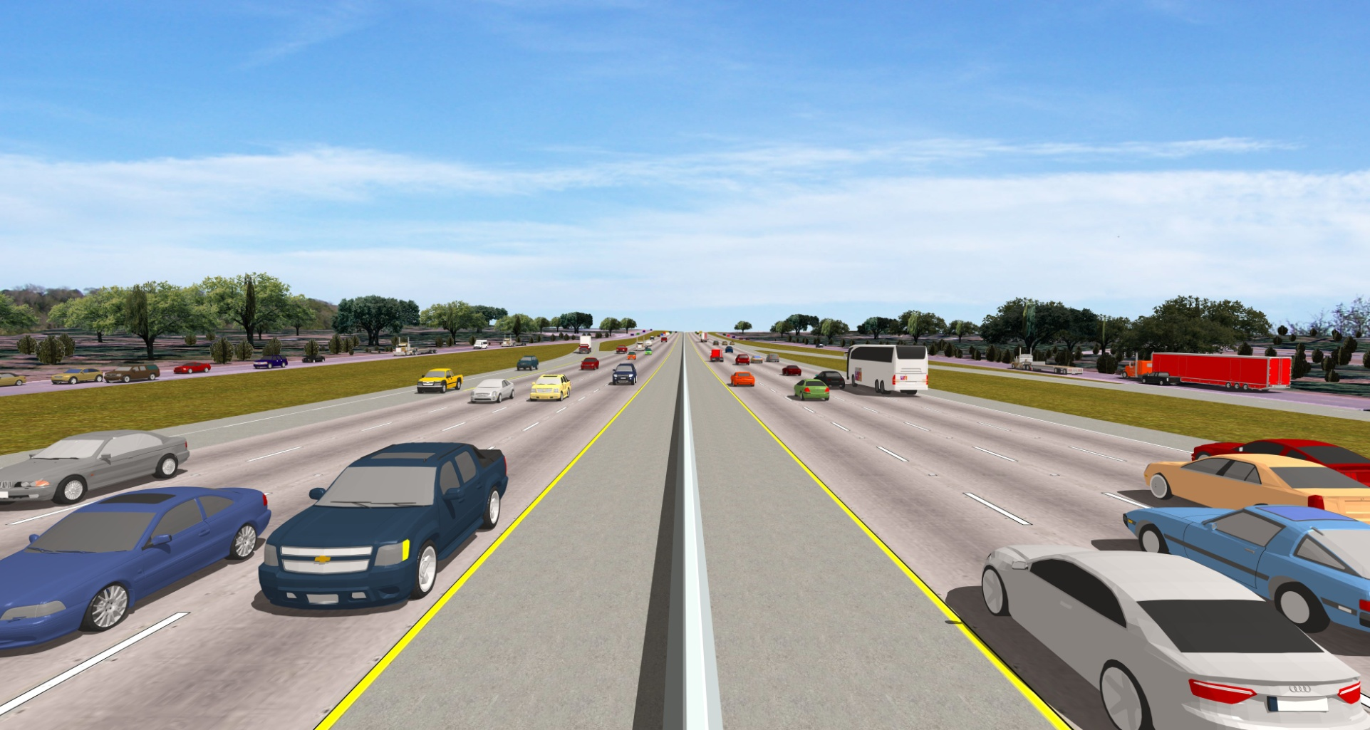
Loop 1604 Potential Alternatives –
Expand lanes to the center

Slide 19
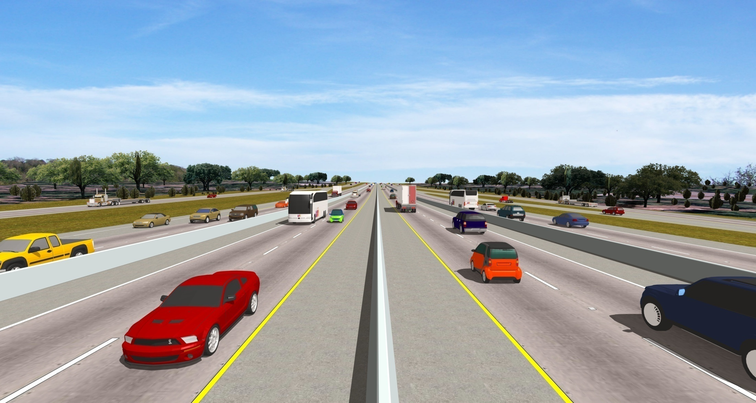
Loop 1604 Potential Alternatives –
Add Managed Lanes to the Center

Slide 20
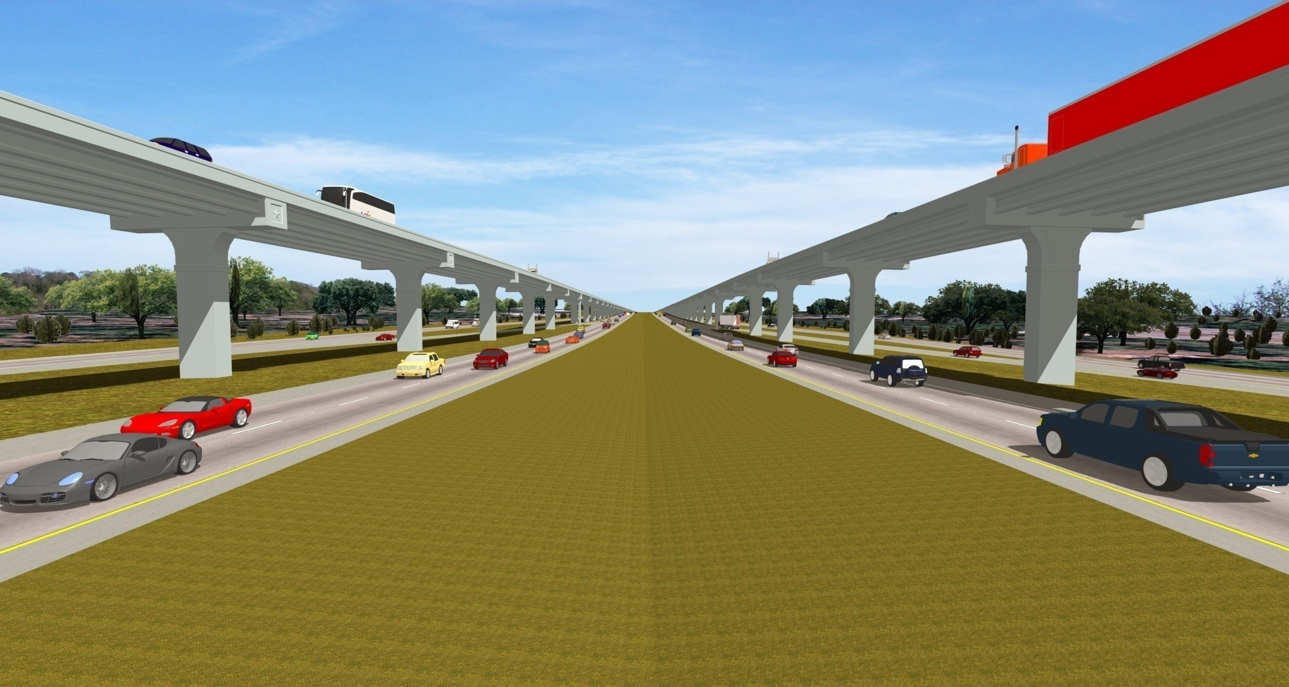
Loop 1604 Potential Alternatives –
Add Elevated Managed Lanes

Slide 21
Funding - Where is it going to come from?
Gas Tax
Bonds
Sales Tax
End Diversions?
Tolls
Vehicle Registration Fee
Property Tax

Slide 22

Stay Informed, Stay Involved!
Want to see more of the animation files?
Want to stay up to date on the proposed projects? - Follow us online!
www.AlamoRMA.org
www.411on281.com
www.MoreFor1604.com

Slide 23
www.AlamoRMA.org

